Slide 1
Module 8 Class Problems
Part 1 Hydropower

Slide 2
Q1. A hydropower station in Japan commissioned a new turbine and a generator with the following specifications:
mass flow rate = 207,000 kg/s
Net head (elevation change minus losses) = 48 m
overall efficiency = 89%
What is the power output of this system?

Slide 3
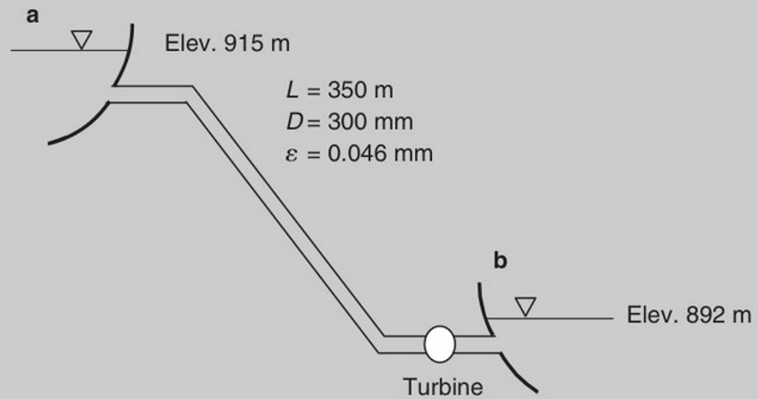
Q2. A proposed design for a hydroelectric project is based on a discharge of 0.25 m³/sec through the penstock and turbine as shown in Figure. Total minor losses can be estimated by k=0.78. Determine the power in kW that can be expected from the facility, if the turbine efficiency is 0.85.
Using turbine’s specific speed, determine the type of turbine to be installed if the desired rotational speed is 1200 RPM

Slide 4
Q3. A turbine develops 15,500 hp with a decrease in head of 37 ft and a rotational speed of 106 RPM. What type of turbine is best suited for this application?

Slide 5
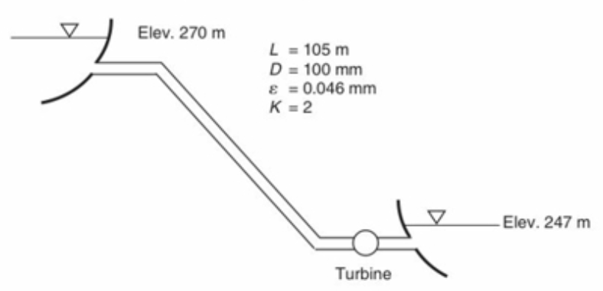
Q4. A developer has constructed an elevated reservoir, as shown in the sketch, and estimates that a flow rate of 200 L/min is available on a continuous basis.
Determine the power in kW that can be expected from the arrangement, if the turbine efficiency is 0.85.
if the turbine runs approximately 4000 hrs in the year, determine the yearly electricity production of the plant.
if the cost of the installed cost of this hydropower is 2500 $/kW, determine the LCOE from this plant. Assume negligible operating costs

Slide 6
Q5. If a hydroelectric facility is to produce 100,000 hp with an elevation difference of 300 feet, what is a suitable speed (in RPM) if a Kaplan turbine, operating at high efficiency, is used?

